Slide 1
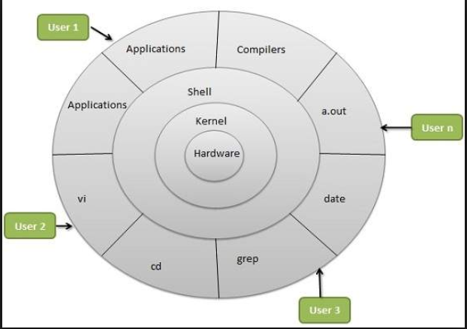
OS

Slide 2
1. pwd — When you first open the terminal, you are in the home directory of your user. To know which directory you are in, you can use the “pwd” command. It gives us the absolute path, which means the path that starts from the root. The root is the base of the Linux file system. It is denoted by a forward slash( / ). The user directory is usually something like "/home/username".
2. ls — Use the "Is" command to know what files are in the directory you are in. You can see all the hidden files by using the command “ls -a”.
3. man & --help — To know more about a command and how to use it, use the man command. It shows the manual pages of the command. For example, “man cd” shows the manual pages of the cd command. Typing in the command name and the argument helps it show which ways the command can be used (e.g., cd –help)
4. Uptime -uptime gives a one line display of the following information. The current time, how long the system has been running, how many users are currently logged on, and the system load averages for the past 1, 5, and 15 minutes.
5. whoami-The whoami command writes the user name (i.e., login name) of the owner of the current login session to standard output.
6. Cal - The cal command displays a simple, formatted calendar in your terminal.

Slide 3
7. Date - The date command displays the current date and time. It can also be used to display or calculate a date in a format you specify.
Date +%T → to display only time
File Creation:
8. touch — The touch command is used to create a file. It can be anything, from an empty txt file to an empty zip file. For example, “touch new.txt”.
8.1 cat → cat > new.txt (After writing the content prese ctrl + D to save and come out)
8.2 vi -→ vi new.txt
9. mkdir — Use the mkdir command when you need to create a folder or a directory. For example, if you want to make a directory called “DIY”, then you can type “mkdir DIY
10.Ifconfig - stands for "interface configuration". It is used to view and change the configuration of the network interfaces on your system
11. sudo — A widely used command in the Linux command line, sudo stands for "SuperUser Do". So, if you want any command to be done with administrative or root privileges, you can use the sudo command
12. uname — Use uname to show the information about the system your Linux distro is running. Using the command “uname -a” prints most of the information about the system. This prints the kernel release date, version, processor type, etc

Slide 4
13. hostname — Use hostname to know your name in your host or network. Basically, it displays your hostname and IP address. Just typing “hostname” gives the output. Typing in “hostname -I” gives you your IP address in your network
14.Cat - The cat (short for “concatenate“) command is one of the most frequently used command in Linux/Unix like operating systems. cat command allows us to create single or multiple files, view contain of file, concatenate files and redirect output in terminal or files (ex : cat filename)
15.Cd - The cd command changes the current directory in Linux and can toggle between directories conveniently. Cd is similar to the CD and CHDIR commands in MS-DOS (ex : cd dirname )
16. cp — Use the cp command to copy files through the command line. It takes two arguments: The first is the location of the file to be copied, the second is where to copy.(ex : cp abc.txt sample/)
16.1The source and destination files may also reside in different directories
cp /home/chuck/pictures/picture.jpg /home/chuck/backup/picture.jpg
16.2Copying Multiple Files To A Directory
cp ~/pictures/picture-*.jpg ~/picture-backup
16.3Copying Files Recursively
You can use cp to copy entire directory structures from one place to another
cp -R ~/files ~/files-backup
16.4 Recursively copies all the files, directories, and subdirectories in the /home/hope/filesdirectory into the /home/hope/backup directory
cp -R /home/hope/files/* /home/hope/backup

Slide 5
17. Mv - mv command is used to move files and directories.
17.1Move all C files in current directory to subdirectory bak
mv *.c bak
17.2Move all files in subdirectory bak to current directory
mv bak/* .
17.3 Rename file main.c to main.bak:
mv main.c main.bak
18.Rm - The rm ("remove") command is used to delete files. When used recursively, it may be used to delete directories.
18.1 if there is a file in your current directory named "-file.txt", you can delete it with the command
rm -file.txt
18.2 Remove the file myfile.txt. If the file is write-protected, you will be prompted to confirm that you really want to delete it
rm -f myfile.txt
18.3 Remove all files in the working directory. If it is write-protected, you will be prompted before rm removes it
rm -f *
18.4 Remove the directory mydirectory, and any files and directories it contains
rm -r mydirectory

Slide 6
19.Rmdir - The rmdir command removes each directory specified on the command line, if they are empty. That is, each directory removed must contain no files or directories, or it cannot be removed by rmdir.
19.1 Remove the directory mydir, if it is empty.
rmdir mydir
19.2 remove dir/subdir, then attempts to remove dir.
rmdir -p dir/subdir
20.Find - Find Command is one of the most important and much used command in Linux sytems. Find command used to search and locate list of files and directories based on conditions you specify
20.1 Find all the files whose name is tecmint.txt in a current working directory
find . -name tecmint.txt
20.2 Find Files Under Home Directory
find /home -name tecmint.txt
20.3 Find Files Using Name and Ignoring Case
find /home -iname tecmint.txt
20.4 Find Directories Using Name
find / -type d -name Tecmint
20.5 Find all PHP Files in Directory
find . -type f -name "*.php"

Slide 7
20.6 Find Files With 777 Permissions
find . -type f -perm 0777 -print
20.7 Find Read Only Files
find / -perm /u=r
20.8 Find Executable Files
find / -perm /a=x
20.9 Find all Empty Files
find /tmp -type f -empty
20.10 Find all Empty Directories
find /tmp -type d -empty
20.11 File all Hidden Files
find /tmp -type f -name ".*"
20.12 Find Single File Based on User
find / -user root -name tecmint.txt
20.13 Find all Files Based on User
find /home -user tecmint
20.14 Find all Files Based on Group
find /home -group developer
20.15 Find Last 50 Days Modified Files
find / -mtime 50
20.16 Find Last 50 Days Accessed Files
find / -atime 50

Slide 8
20.17 Find Changed Files in Last 1 Hour
find / -cmin -60
20.18 Find 50MB Files
find / -size 50M
21.Grep - grep is a powerful file pattern searcher that comes equipped on every distribution of Linux
21.1 grep "string" FILE_PATTERN
grep "this" demo_file
21.2 To Ignore case sensitivity
grep -i "string" FILE
21.3 To display N lines after match
grep -A <N> "string" FILENAME
21.4 To display N lines before match
grep -B <N> "string" FILENAME
21.5 To search particular word
grep -w "string" FILE
21.6 Reverse finding
grep -v "string" FILE
21.7 search all files recursively
grep -r "ramesh" *
21.8 Count the no of matches
grep -c "pattern" filename

Slide 9
21.9 Display the files which matches the pattern
grep -l this demo_*
21.10 Regular expressions
grep '^fred' /etc/passwd
grep '[FG]oo' * ---> the char word either F or G starts with
grep '[0-9][0-9][0-9]' * the digit word
21.11# search for multiple patterns, all files in current dir
employee.txt
100 Thomas Manager Sales $5,000
200 Jason Developer Technology $5,500
300 Sanjay Sysadmin Technology $7,000
400 Nisha Manager Marketing $9,500
500 Randy DBA Technology $6,000
egrep [JNR] employee.txt
egrep [6-9] employee.txt
egrep 'Marketing|DBA' employee.txt
22.sed is a stream editor. A stream editor is used to perform basic text transformations on an input stream (a file, or input from a pipeline)

Slide 10
22.1 sed 's/Nick/John/' report.txt --> find and replace 1st occurance
22.2 sed 's/Nick/John/g' report.txt --> find and replace all occurances
22.3 sed 's/foo/bar/4' file.txt --> find and replace that exact occurance
22.4 sed -n 12,18p file.txt --> range of lines to print
22.5 sed 12,18d file.tx --> range of lines to delete
22.6 sed '$d' file.txt --> delete the last line
22.7 sed '1~3d' file.txt --> delete every third line starting with 1
22.8 sed -n '2~5p' file.txt --> print every 5th line starting with 2
22.9 sed '/^$/d' --> delete all the blank lines
23.Head - The head command reads the first few lines of any text given to it as an input and writes them to standard output
Tail - The tail command is a command-line utility for outputting the last part of files given to it via standard input. It writes results to standard output.
23.1 Head filename (print first 10 lines default)
23.2 head -5 filename (5 lines will be displayed)
23.3 tail filename(print last 10 lines )
23.4 tail -5 filename(last 5 lines)
23.5 The Linux tail command has another very powerful option: the -f option prints from the end of the file, but also keeps the file open, and keeps printing from the tail of the file as the file itself grows. This is great for looking at the end of a log file. For instance, you can see new lines that are added to the end of an Apache log file, as they are added, like this (tail –f sample.log)

Slide 11
24. Xargs - The xargs command in UNIX is a command line utility for building an execution pipeline from standard input. Whilst tools like grep can accept standard input as a parameter, many other tools cannot. Using xargs allows tools like echo and rm and mkdir to accept standard input as arguments.
24.1 echo 'one two three' | xargs mkdir
24.2 find /tmp -mtime +14 | xargs rm
24.3 find / -type f -name "*.txt" | xargs rm
24.4 echo 'one two three' | xargs -t rm (-t print the executoin)
24.5 echo 'one two three' | xargs -p touch (-p to ask confirmation before execute)
25. tee command reads the standard input and writes it to both the standard output and one or more files
25.1 ls -1 *.txt | wc -l | tee count.txt
25.2 ls -1 *.txt | wc -l | tee -a count.txt (-a append the data to the file)
26. Cut - The cut command in UNIX is a command for cutting out the sections from each line of files and writing the result to standard output. It can be used to cut parts of a line by byte position, character and field
Cut by Character
26.1 cut -c 2 cut.txt
26.2 cut -c 2-5 cut.txt

Slide 12
Cut By Field
cut -d':' -f1 /etc/passwd (-d is delimiter -f1 first field)
cut -d':' -f1,6 /etc/passwd (1st and 6th columns)
cut -d':' -f1-3 /etc/passwd (1st to 3rd columns)
27. Awk is a scripting language used for manipulating data and generating reports.The awk command programming language requires no compiling, and allows the user to use variables, numeric functions, string functions, and logical operators.
1) Amit Physics 80
2) Rahul Maths 90
3) Shyam Biology 87
4) Kedar English 85
5) Hari History 89
Printing Column or Field
awk '{print $3 "\t" $4}' marks.txt
Printing All Lines
awk '/a/ {print $0}' marks.txt (search for 'a' and display entire record)
If statement
awk 'BEGIN {num = 10; if (num % 2 == 0) printf "%d is even number.\n", num }'

Slide 13

If Else Statement
awk 'BEGIN {
num = 11; if (num % 2 == 0) printf "%d is even number.\n", num;
else printf "%d is odd number.\n", num
}’
For loop
awk 'BEGIN { for(i=1;i<=5;i++) print "square of", i, "is",i*i; }'
28. Crontab : The crontab is used for running specific tasks on a regular interval, crontab is very useful for routine tasks like scheduling system scanning, daily backups etc

Slide 14
28.1crontab -l --> list of jobs
28.2crontab -e --> to modify
28.3 crontab -u username -l --> particular user
28.4 crontab -r ---> remoe all the cron jobs
28.5 crontab -r -u username --> delete specific user jobs
Examples:
5 0 * * * /path/to/command --> five minutes after midnight, every day
15 14 1 * * /path/to/script.sh --> 2:15pm on the first of every month
0 22 * * 1-5 /scripts/phpscript.php --> 10pm on weekdays
23 0-23/2 * * * /root/scripts/perl/perlscript.pl ---> at 23 minutes after midnight, 2am, 4am …, everyday,
@reboot Run once, at startup.
@yearly Run once a year, “0 0 1 1 *”.
@annually (same as @yearly)
@monthly Run once a month, “0 0 1 * *”.
@weekly Run once a week, “0 0 * * 0”.
@daily Run once a day, “0 0 * * *”.
@midnight (same as @daily)
@hourly Run once an hour, “0 * * * *”

Slide 15
29. Process:
Process --> When you execute a program on your Unix system, the system creates a special environment for that program
PID ---> The operating system tracks processes through a five-digit ID number known as the pid or the process ID
Process types:
Fore Ground : Commands which are running are fore ground
Back Ground : after command give &, it will run back ground so that we can work on other commands as well
29.1 ps :command without any arguments, it displays processes for the current shell.
29.2 ps –e :every active process on a Linux system in generic (Unix/Linux) format.
29.3 ps –ef : perform a full-format listing
29.4 ps –x :Display User Running Processes
29.5 ps –e –forest : A process tree shows how processes on the system are linked to each other; processes whose parents have been killed are adopted by the init (or systemd)
29.6 ps –ef | grep service : search specific process and pid
29.7 kill pid : kill ProcessID
29.8 kill -9 pid : kill ProcessID forcefully

Slide 16
30. TOP : top is a task manager program found in many Unix-like operating systems that displays information about CPU and memory utilization
30.1 top : it will show information like tasks, memory, cpu and swap. Press ‘q‘ to quit window
30.2 ‘u’ Display Specific User Process
30.3 ‘z’ Running Process in Top
30.4 ‘k’ Kill running process
31. USER Management
user information ---> etc/passwd
[username]:[x]:[UID]:[GID]:[comment]:[home_dir]:[default-shell]
Group information ---> etc/group
[group]:[group-password]:[GID]:[group-members]
creating user
useradd username
passwd <user name> --> to create password
useradd username -e <date> --> expiry date for the user
useradd uesrname -s <shell> --> default shell

Slide 17
delete user
userdel <user-name> ---> delete user not home directory and other files
userdel -r <user-name> --> delete all the files
Modiyf user
usermod [options] [user-name]
usermod --expiredate 2015-08-30 testuser
Changing Default Location of User’s Home Directory
Use -d or —home option, followed by the absolute path to the new home directory.
usermod --home /tmp testuser
Changing the Shell the User will use by Default
Use -s or –shell option, followed by the path to the new shell.
usermod --shell /bin/sh testuser
Disabling Account by Locking Password
Use -L or –lock option to lock a user’s password or disable a user account.
usermod --lock testuser
Unlocking User Password
Use –u or –unlock option to unlock a user’s password that was previously locked or a user that was disabled.
usermod --unlock testuser

Slide 18
Adding User to Supplementary Groups
Use the combined -aG or —append —groups option, followed by a comma separating list of groups.
usermod --append --groups root,test-users testuser (adding extra groups)
To check user information(expirey date, etc..)
chage -l username
change expirey date
chage -E "yyyy-mm-dd" user
chage -E "2009-05-31" dhinesh
After pword expiry maximum no of days allow to change
chage -I Noofdays user (after days account will lock)
chage -I 10 dhinesh
32. Creating a New Group
To create a new group we can simply use <b>groupadd</b> command.
$ groupadd test_group

Slide 19
The following command will change group owner of test_file.txt to test_group.
$ chown :test_group test_file.txt
In order to add a test-user to test_group we run the following command:
$ usermod -aG test_group test-user
groupmod -n bettergroup newgroup (change group)
Deleting a Group
We can delete a group using the following command,
$ groupdel [group]
33. FILE PERMISSION
adding permissions to user to a particular file
chmod o+w foo.txt (adding write access to others)
Remove read and write permissions
chmod go-rw foo.txt (remove read and write permissions for group and others)
Identities
u — the user who owns the file (that is, the owner)
g — the group to which the user belongs
o — others (not the owner or the owner's group)
a — everyone or all (u, g, and o)

Slide 20
Permissions
r — read access
w — write access
x — execute access
Actions
+ — adds the permission
- — removes the permission
= — makes it the only permission
chmod a-rwx foo.txt (remove all permissions to all)
g=rx — allows only the group to read and execute (not write)
ug+r — allows the owner and group to read the file
using numbers we can give access (4-->read, 2--->write and 1--> execute)
chmod 777 sample.txt (giving all permissions to all )
Changing group permission
chgrp hope file.txt (group is updated with hope)
changing ownership for multiple files
chown hope file1 file2 file3
or
chown hope file*

Slide 21
Changing owner and group of a file
chown newuser:newgroup file
Changing owner and group of directory and it's files
chown -R myuser:mygroup directory
34. COMPRESSING FILES
ZIP/UNZIP
34.1 zip squash.zip file1 file2 file3 (squash.zip is the name and files are file*)
34.2 zip a directory
zip -r squash.zip dir1
34.3 To uncompress:
unzip squash.zip
TAR command
tar -cvf tecmint-14-09-12.tar /home/tecmint/
c – Creates a new .tar archive file.
v – Verbosely show the .tar file progress.
f – File name type of the archive file.

Slide 22
Create tar.gz Archive File
tar cvzf MyImages-14-09-12.tar.gz /home/MyImages (Z is for compression)
Untar tar Archive File
tar -xvf public_html-14-09-12.tar
Uncompress tar.gz Archive File
tar -xvf thumbnails-14-09-12.tar.gz
List Content of tar Archive File
tar -tvf uploadprogress.tar
List Content tar.gz Archive File
tar -tvf staging.tecmint.com.tar.gz
Untar Single file from tar File
tar -xvf cleanfiles.sh.tar cleanfiles.sh
Untar Single file from tar.gz File
tar -zxvf tecmintbackup.tar.gz tecmintbackup.xml
Append a file to tar
tar --append --file=collection.tar rock
Delete a file from tar
bash$ tar -dvf archive.tar filename.txt

Slide 23
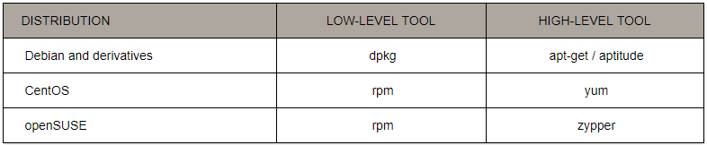

35. Package Management
Installing a package from a compiled (*.deb or *.rpm) file
Installing a package from a repository
Removing a package
Displaying information about a package

Slide 24
36. Start/stop/restart services
1. Open the command line 2. Enter ls /etc/init.d or ls /etc/rc.d/ 3. Find the name of the service you want to restart. 4. Enter sudo systemctl restart service where service is the service name.
Example :
sudo systemctl stop httpd
Sudo systemctl start httpd
Sudo systemctl restart httpd
sudo service httpd start
​sudo service httpd stop
​sudo service httpd restart

Slide 25


37.Create SSH Keys
38. SCP - SECURE FILE COPY
39. netstat (network statistics) is a command line tool for monitoring network connections both incoming and outgoing as well as viewing routing tables, interface statistics etc
netstat –a : List out all connections
netstat –at or netstat –au : List only TCP or UDP connections
netstat –ant : Disable reverse dns lookup for faster output
netstat –tnl: List out only listening connections

Slide 26
40. wget: is a Linux/UNIX command line file downloader
41.Ping : The PING command is used to test the connection and latency between two network connections. (ex : Ping www.google.co.in )
42. Df : The df command reports the amount of available disk space being used by file systems
Df → Display all file systems and their disk usage
Df -h → Display all file systems and their disk usage in "human readable"
43. Du : du estimates and displays the disk space used by files.
du -s *.txt → Reports the size of each file in the current directory with the extension .txt
du -shc *.txt → Reports the size of each file in the current directory with the extension .txt in human readable format
44. View all Disk Partitions in Linux
Fdisk -l → to view all available partitions on Linux

Slide 27
45. Free : free displays the total amount of free and used physical memory and swap space in the system
46. WC : The wc (word count) command in Unix/Linuxoperating systems is used to find out number of newline count, word count, byte and characterscount in a files specified by the file arguments.
Example:
wc myfile.txt (Displays total number of lines, words and characters of the f ile)
Wc –c myfile.txt (Total number of characters in the file
Wc –w myfile.txt (Total number of words in the file)
Wc –l myfile.txt (Total number of lines in the file)
47. SORT command sorts the contents of a text file, line by line
sort data.txt (sort in ascending order)
sort -r data.txt (sort in reverse order)
48. Diff :This command is used to display the differences in the files by comparing the files line by line.
diff file1.txt file2.txt

Slide 28

49. Comm : Compare sorted files FILE1 and FILE2 line-by-line.
Here, each line of output has either zero, one, or two tabs at the beginning, separating the output into three columns:
The first column (zero tabs) is lines that only appear in the first file.
The second column (one tab) is lines that only appear in the second file.
The third column (two tabs) is lines that appear in both files.
Examples:
comm -1 -3 file1 file2
comm <(sort employee.txt) <(sort marks.txt)
comm -12 recipe.txt shopping-list.txt
comm recipe.txt shopping-list.txt > output.txt

Slide 29
50. cmp: is used to compare two files byte by byte. If a difference is found, it reports the byte and line number where the first difference is found
cmp file1.txt file2.txt
NFS :
NFS (Network File System) is basically developed for sharing of files and folders between Linux/Unix systems
Setup and Configure NFS Mounts on Linux Server
NFS Server: nfsserver.example.com with IP-192.168.0.5
NFS Client : nfsclient.example.com with IP-192.168.0.3
Installing NFS Server and NFS Client
yum install nfs-utils nfs-utils-lib
/etc/init.d/nfs start or service nfs start
chkconfig --level 35 nfs on

Slide 30
Setting Up the NFS Server
Configure Export directory
For sharing a directory with NFS, we need to make an entry in “/etc/exports” configuration file. Here I’ll be creating a new directory named “nfsshare” in “/” partition to share with client server, you can also share an already existing directory with NFS.
[root@localhost ~]# mkdir /nfsshare
Now we need to make an entry in “/etc/exports” and restart the services to make our directory shareable in the network.
[root@localhost ~]# vi /etc/exports
/nfsshare 192.168.0.3(rw,sync,no_root_squash)
In the above example, there is a directory in / partition named “nfsshare” is being shared with client IP “192.168.0.3” with read and write (rw) privilege, you can also use hostname of the client in the place of IP in above example.

Slide 31
Setting Up the NFS Client
After configuring the NFS server, we need to mount that shared directory or partition in the client server
Mount Shared Directories on NFS Client
Now at the NFS client end, we need to mount that directory in our server to access it locally. To do so, first we need to find out that shares available on the remote server or NFS Server.
[root@localhost ~]# showmount -e 192.168.0.5
Export list for 192.168.0.5:
/nfsshare 192.168.0.3
Above command shows that a directory named “nfsshare” is available at “192.168.0.5” to share with your server.
Mount Shared NFS Directory
[root@localhost ~]# mount -t nfs 192.168.0.5:/nfsshare /nfsshare
[root@localhost ~]# mount | grep nfs
sunrpc on /var/lib/nfs/rpc_pipefs type rpc_pipefs (rw,relatime)
nfsd on /proc/fs/nfsd type nfsd (rw,relatime)
192.168.0.5:/nfsshare on /nfsshare type nfs4 (rw,relatime,vers=4.1,rsize=262144,wsize=262144,namlen=255,hard,proto=tcp,port=0,timeo=600,retrans=2,sec=sys,clientaddr=192.168.0.3,local_lock=none,addr=192.168.0.5)

Slide 32
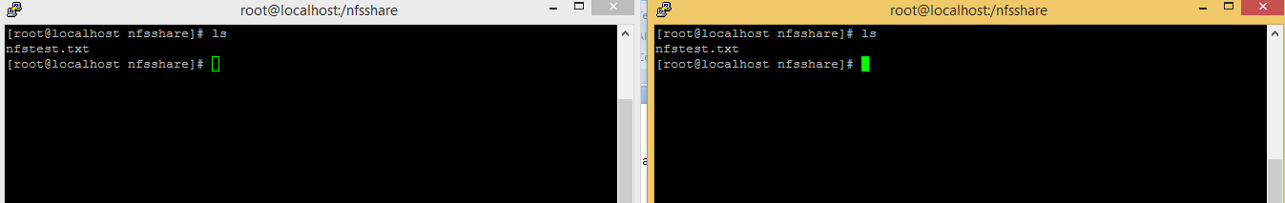
Test the Working of NFS Setup
We can test our NFS server setup by creating a test file on the server end and check its availability at nfs clientside or vice-versa.
[root@localhost nfsshare]# cat > /nfsshare/nfstest.txt

Slide 33
Configure Postfix to Use Gmail SMTP on Ubuntu
Step-1 : sudo apt-get install postfix mailutils libsasl2-2 ca-certificates libsasl2-modules
If you do not have postfix installed before, postfix configuration wizard will ask you some questions. Just select your server as Internet Site and for FQDN use something like mail.example.com (user choice)
Step-2: vim /etc/postfix/main.cf (add the below lines, relayhost will be exist already remove the property or update)
relayhost = [smtp.gmail.com]:587
smtp_sasl_auth_enable = yes
smtp_sasl_password_maps = hash:/etc/postfix/sasl_passwd
smtp_sasl_security_options = noanonymous
smtp_tls_CAfile = /etc/ssl/certs/ca-certificates.crt
smtp_use_tls = yes
You might have noticed that we haven’t specified our Gmail username and password in above lines. They will go into a different file. Open/Create
Step-3: vim /etc/postfix/sasl_passwd
[smtp.gmail.com]:587 username@gmail.com:password

Slide 34
Step-4 : Fix permission and update postfix config to use sasl_passwd file:
sudo chmod 400 /etc/postfix/sasl_passwd
sudo postmap /etc/postfix/sasl_passwd
Step-5 : Finally, reload postfix config for changes to take effect:
sudo /etc/init.d/postfix reload
Testing:
Check if mails are sent via Gmail SMTP server
echo "Test mail from postfix" | mail -s "Test Postfix" you@example.com
Troubleshooting:
If you still haven’t received any mail, check the mail error log.
sudo tail /var/log/mail.log
If the mail log is empty or doesn’t exist, try parsing the syslog. This will return the last 50 entries for postfix.
sudo tail -f -n 50 /var/log/syslog | grep postfix
If the syslog is empty and you still haven’t received any test email, it’s possible that the test email was rejected by the recipient server. You should check to see if anything has bounced back to your mail folder.
sudo less /var/mail/$(whoami)

Slide 35
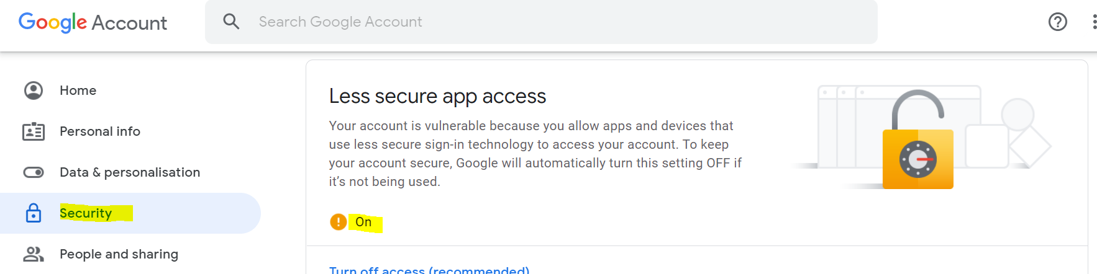
Error: “SASL authentication failed; server smtp.gmail.com”
You need to unlock the captcha by visiting this page https://www.google.com/accounts/DisplayUnlockCaptcha
You can run test again after unlocking captcha.
Still blocking on the less secure app access

Slide 36
SSL on Apache
Install Packages – httpd, mod_ssl and openssl
yum install mod_ssl openssl
Create apache config file under /etc/httpd/conf.d/
webserver.conf
<virtualhost *:443>
serveradmin root@3.139.59.27 (ip of apache)
documentroot /var/www/html
sslengine on
sslcertificatefile /etc/pki/tls/certs/server.crt
sslcertificatekeyfile /etc/pki/tls/private/server.key
</virtualhost>
Create Certificate and Private key using openssl
openssl req -x509 -nodes -days 180 -newkey rsa:2048 -keyout server.key -out server.crt

Slide 37
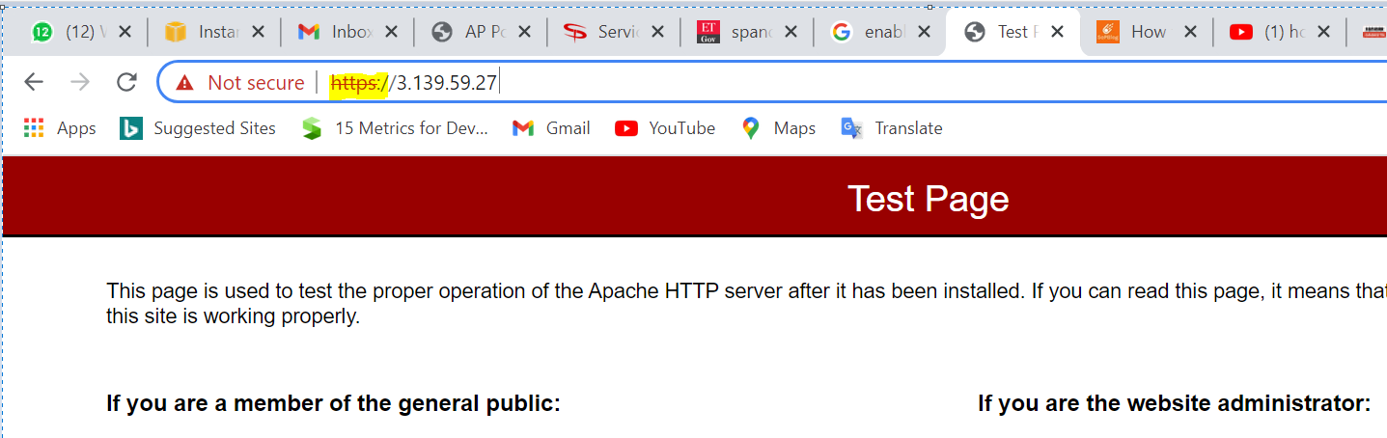
Move the certificate into /etc/pki/tls/certs/
mv server.crt /etc/pki/tls/certs/
Move the private key into /etc/pki/tls/private/
mv server.key /etc/pki/tls/private/
Restart Apache
systemctl restart httpd
Access the website using https

